Slide 1
Topic: Fascism Rises in Europe
Aim: How did fascism change Italy in the 1920’s – 1930’s?

Slide 2
http://www.youtube.com/watch?v=0Vf_gUvPVUU

Slide 3
Fascism
A militant political movement emphasizing loyalty to the state and obedience to its leader.

Slide 4
Characteristics of fascism
Nationalism-the state is more important than the individual
Unity of all classes
All-powerful leader –supreme leader-Mussolini
Extreme militarism
Censorship – gov’t controls the media

Slide 6
Topic: Fascism Rises in Europe
Aim: How did fascism IMPACT Germany in the 1920-1930’s?

Slide 8
http://www.youtube.com/watch?v=3hEG-5_9nK4
http://www.youtube.com/watch?v=cqPc93Pvs0U

Slide 9
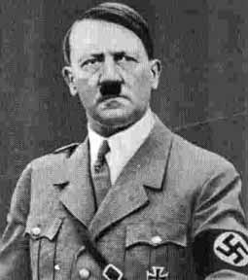
Video
http://www.youtube.com/watch?v=eGhdX1SI3KY&bpctr=1365605305

Slide 12
Text handout

Slide 16
Homework
Reading “Kristallnacht”, answer questions1, 2, 3

