Slide 1
Aim: To what extent did the West African kingdoms experience “Golden Ages”?

Slide 2
Aim: How did trade contribute to the rise of Ghana?

Slide 3
Aim: To what extent did the West African kingdoms experience “Golden Age”?

Slide 4
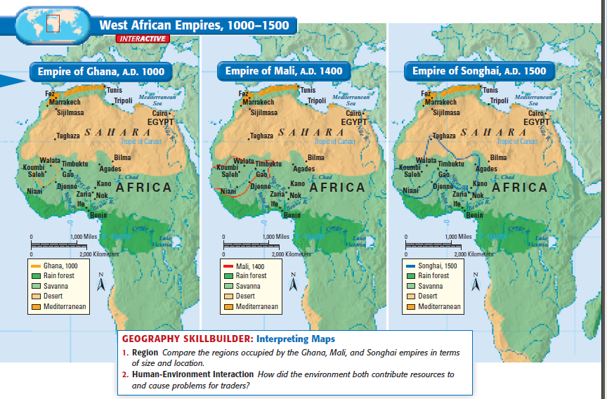

Slide 5
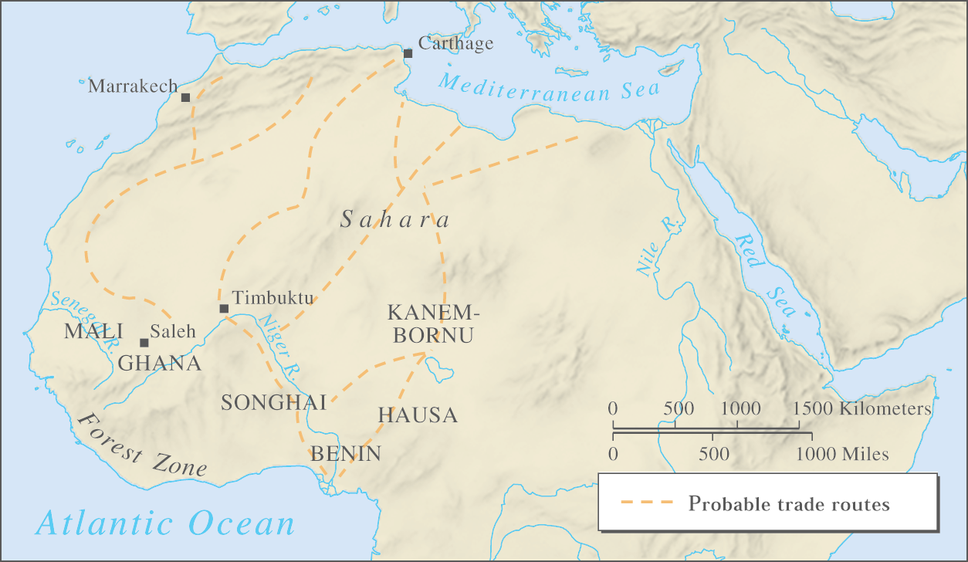
Geographic reference
SALT
GOLD

Slide 6
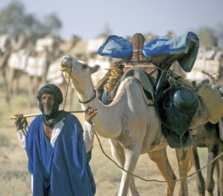
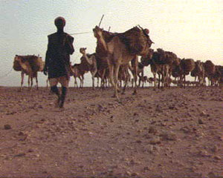
Caravans

Slide 7
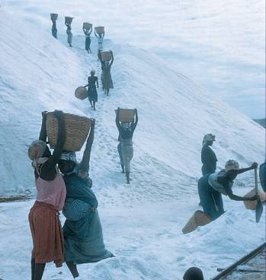
Salt
Plentiful in north & along coast
Berber mines in the Sahara
Used to:
Preserve food *(no refrideration)
Flavor food
Maintain health
Notes:
About 500mg of sodium a day is considered the least you need. That's 1/4 teaspoon of table salt. There is no official recommended daily intake for sodium. However, healthy individuals are advised to limit sodium intake to 2,400mg, and that figure is used for determining the percent daily value for sodium on food labels. Americans now consume about 4,000 milligrams of sodium per day -- about twice the recommended amount.
7

Slide 8
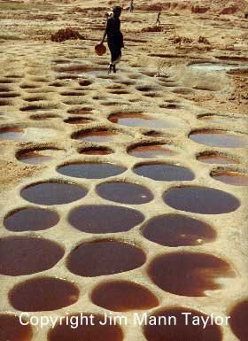
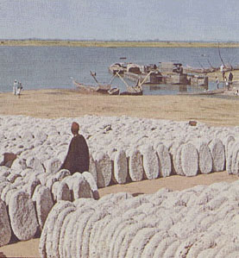
Salt tablets

Slide 9
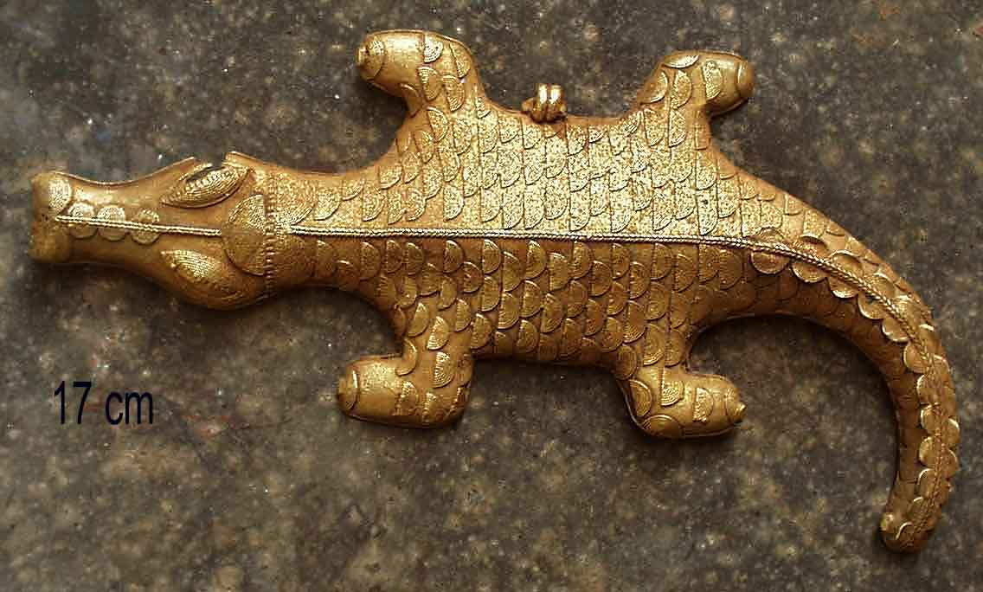

Slide 10
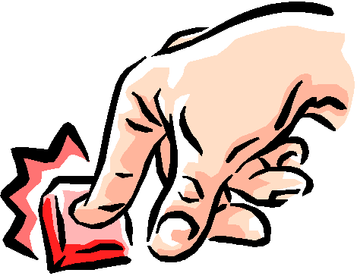
West African trade Routes and Empires, C.E. 1000 - 1500
Interactive map

